Slide 1
Python Test Datacamp

Slide 2
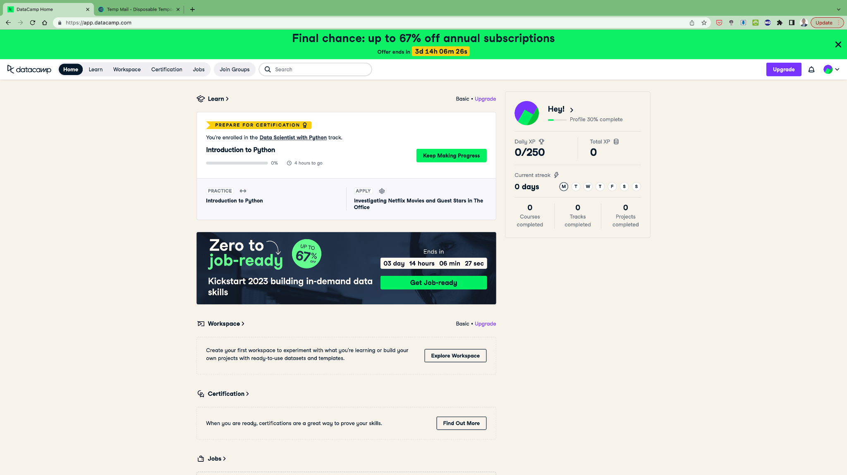

Slide 3
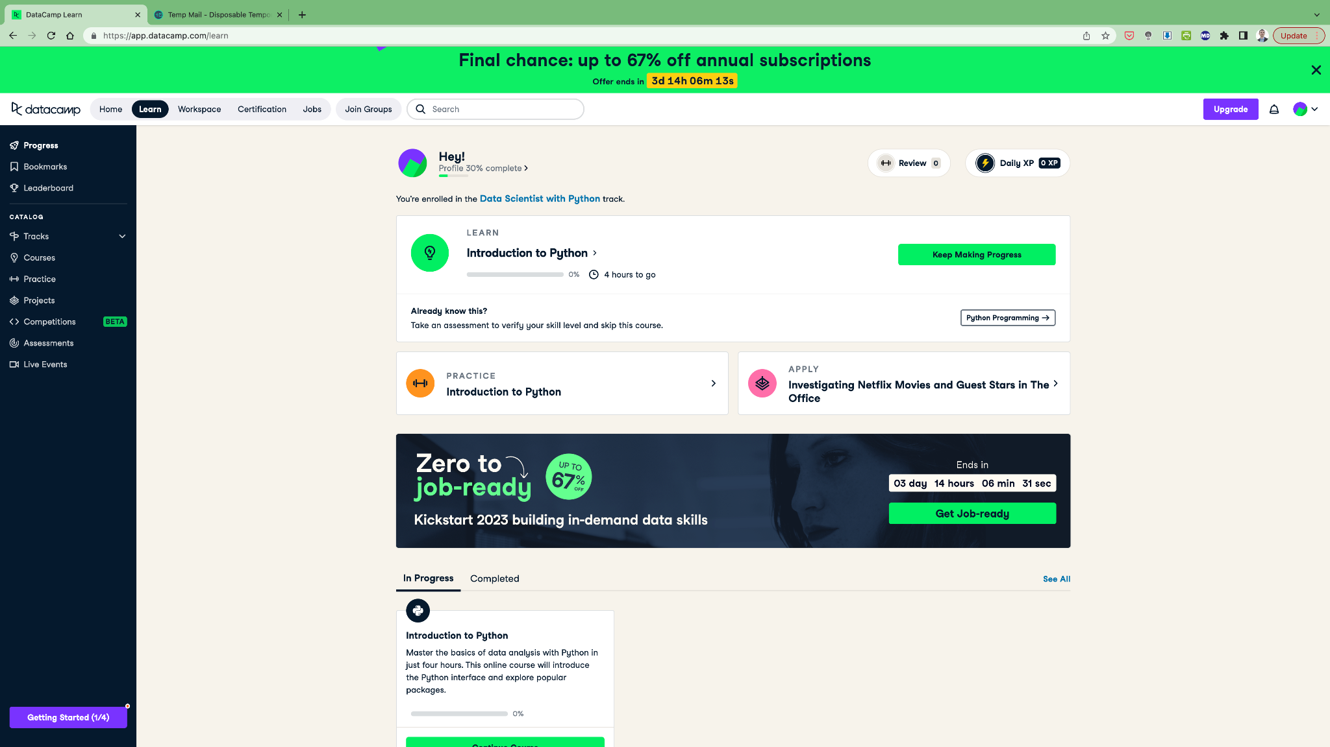

Slide 4
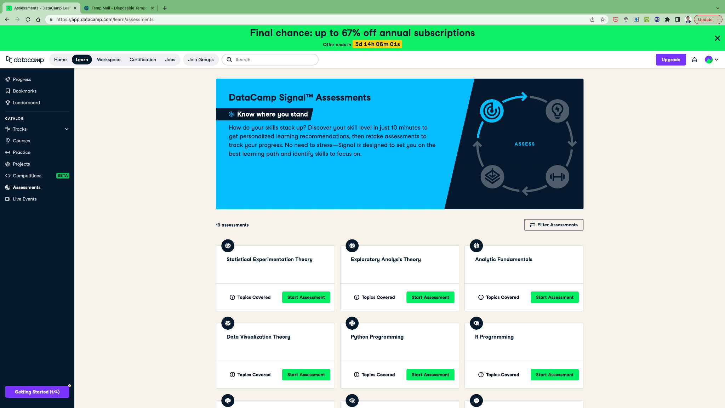

Slide 5
Share your results

Slide 6
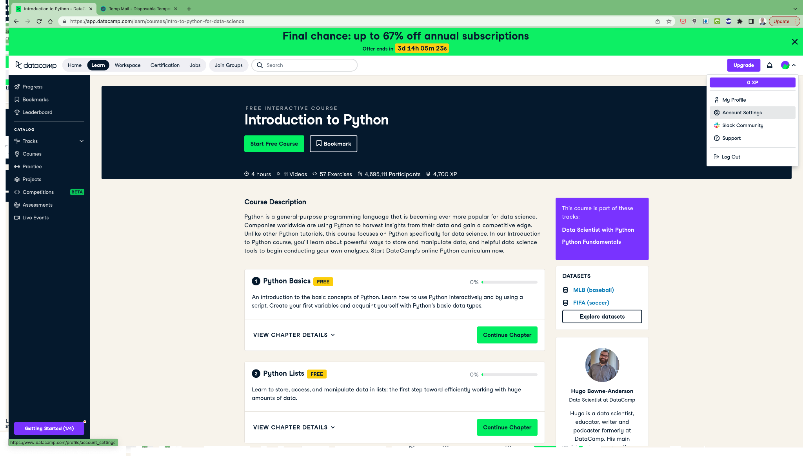

Slide 7
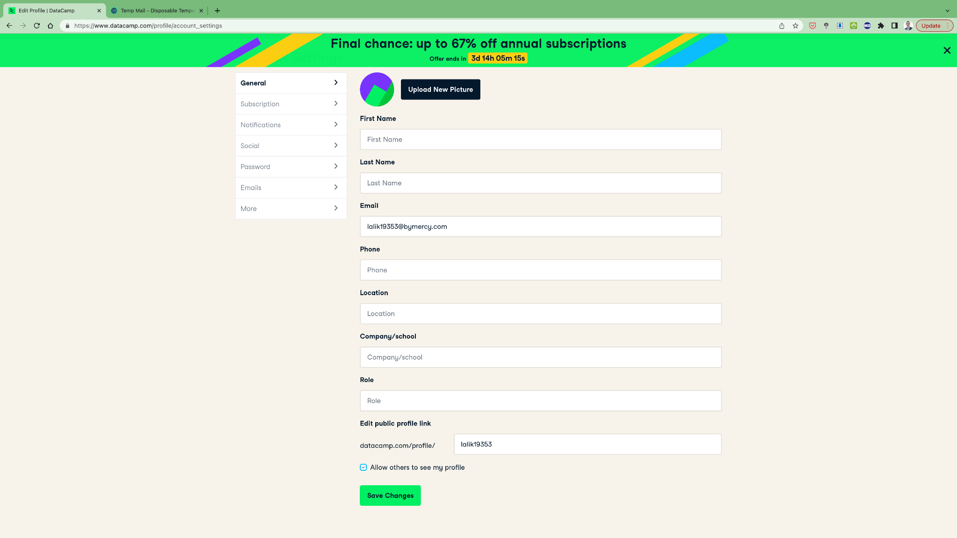
Open this url after saving

Slide 8
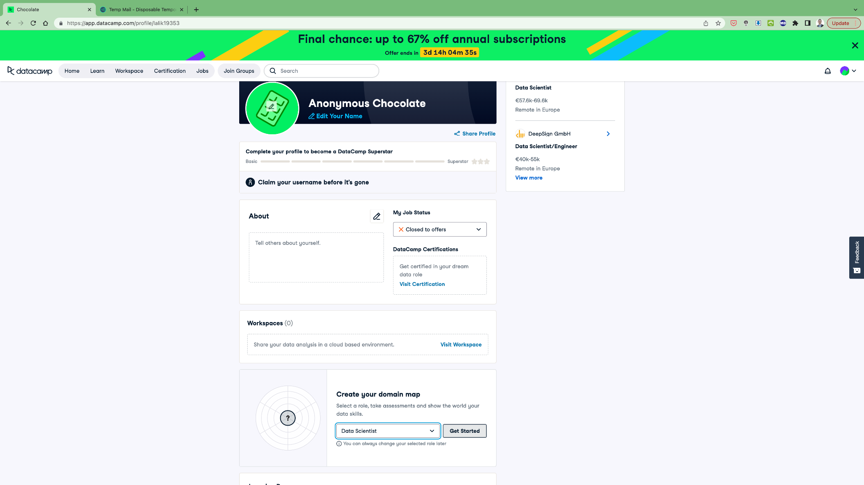

Slide 9
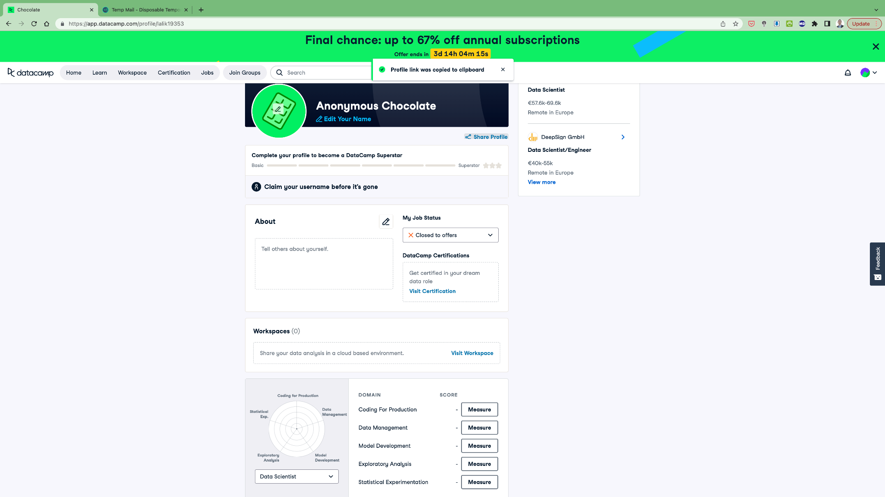
Share with BeCode
This is your score

Slide 10
You can now share your Datacamp profile link with your coach :-)

